Slide 1

Lending Club Case Study

Slide 2

Presentation Outline
Executive Summary
Data Source
Exploratory Data Analysis
Abstract & Problems
Methodology
Evaluation/Results
Business Objectives

Slide 3
Executive Summary
In summary, this company serves as the largest online loan marketplace, providing a range of financial products including personal loans, business loans, and medical procedure financing. The primary financial challenge it faces is credit loss, primarily driven by borrowers who default on their loans, labeled as 'charged-off' customers. To mitigate this risk, the company has embarked on a case study aimed at identifying high-risk loan applicants through exploratory data analysis (EDA). By understanding the critical variables associated with loan defaults, the company can better assess risk and manage its portfolio effectively, ultimately enhancing its financial sustainability and performance.
Lending Club

Slide 4
Abstract & Problems
Abstract
Business Problem
The company must balance loan approvals to minimize financial loss by identifying high-risk applicants through EDA for effective risk assessment and portfolio management.
This case study addresses a critical business problem faced by a consumer finance company specializing in lending various types of loans to urban customers. The primary issue pertains to making loan approval decisions based on applicant profiles, balancing the risks of potential financial loss. The company aims to minimize two types of risks: denying loans to applicants who would repay (resulting in lost business) and approving loans to applicants who might default (leading to financial losses). To tackle this challenge, the study employs Exploratory Data Analysis (EDA) to understand the influence of consumer and loan attributes on the likelihood of loan default.
Analytics Problem
The main challenge is conducting EDA on a loan dataset to identify key variables indicating loan default potential, offering insights for informed loan decisions.

Slide 5




Business Objectives
Reduce credit loss by identifying and cutting loans to high-risk applicants.
Enhance portfolio management and risk assessment with key driver variables.
Understand factors behind loan defaults via EDA for financial sustainability.
Offer easy, low-interest loans through an online platform as a market leader.

Slide 6
Data Source
The data is downloaded from the Upgrad. It contains the complete loan data for all loans issued through the time period 2007 to 2011.
1
2
Loan.csv
Data Dictionary.xlsx
It contains the complete loan data for all loans issued through the time period 2007 t0 2011.
data dictionary which describes the meaning of these variables

Slide 7









Methodology
8. Visual Communication
1. Data Collection
Prepare clear and insightful visualizations and reports.
Communicate the EDA results to stakeholders effectively.
Gather relevant data sources and datasets for analysis.
Ensure data integrity, consistency, and quality.
7. Data Interpretation
Draw conclusions from the EDA findings.
Make informed decisions or recommendations based on the analysis.
2. Data Cleaning
Handle missing values, outliers, and data inconsistencies.
Standardize data formats and remove noise.
6. Exploratory Data Analysis
3. Data Visualization
Investigate relationships and correlations between variables.
Identify potential outliers and anomalies.
Create charts, graphs, and plots to visualize data distributions and relationships.
Explore patterns and trends within the data.
5. Data Preprocessing
4. Descriptive Statistics
Normalize or scale data as necessary.
Encode categorical variables into numerical format (if applicable).
Compute summary statistics (mean, median, standard deviation, etc.) for key variables.
Identify central tendencies and variability in the data.

Slide 8
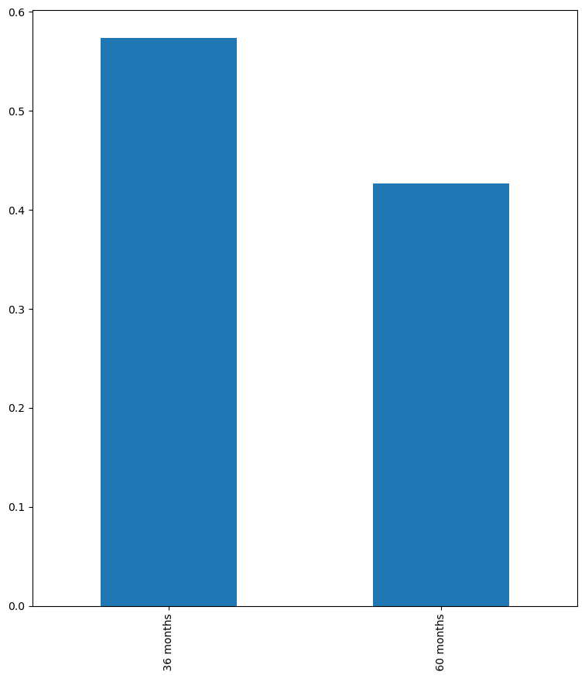
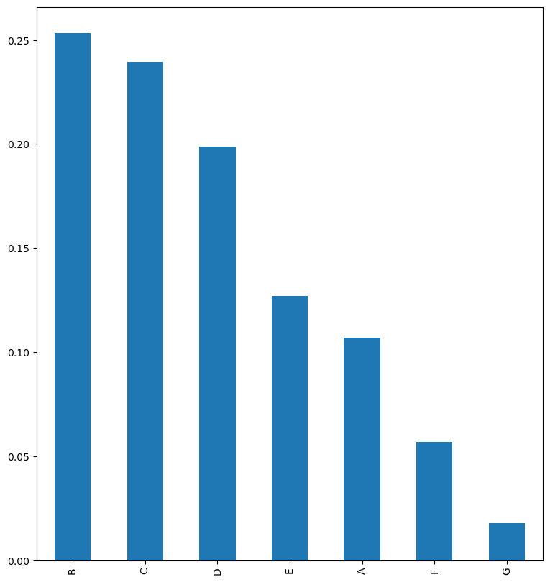
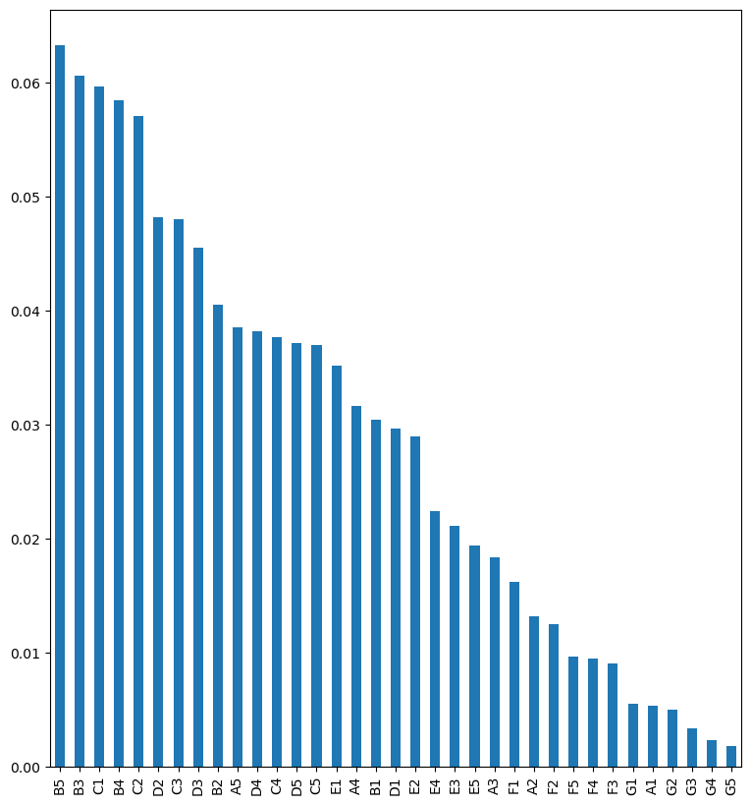
Exploratory Analysis – Key Findings
Defaulters % by Term
Defaulters % by Grade
Defaulters % by Sub Grade
Loans with a 36-month term have a higher default rate compared to those with a 60-month term.
Loans with grades B, C, and D have a higher default rate compared to loans with other grades.
The top 5 subgrades with the highest default rates are B5, B3, C1, B4, and C2.

Slide 9
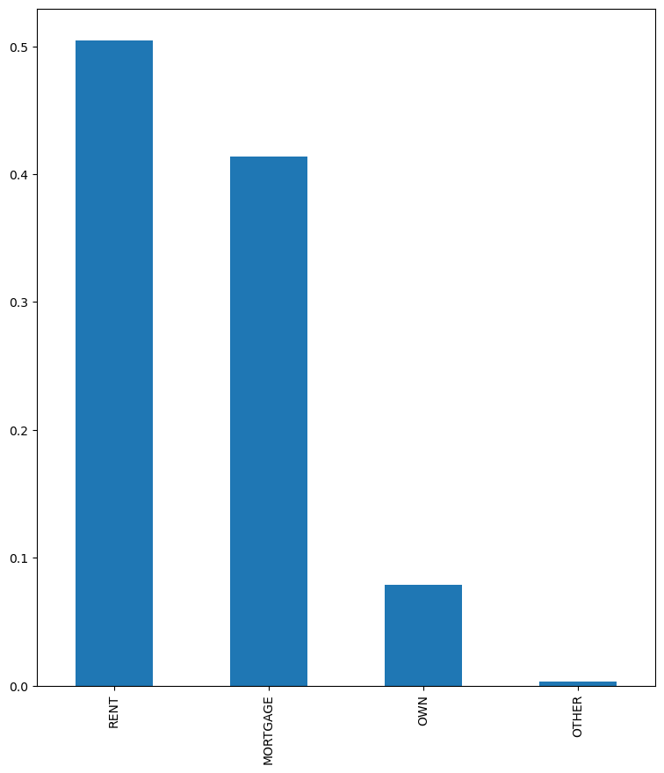
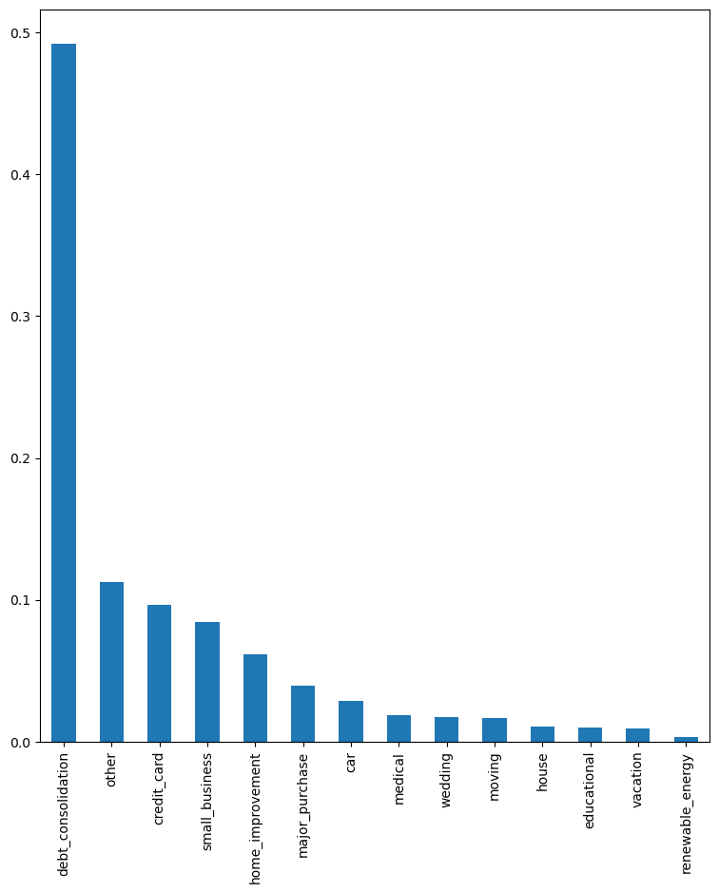
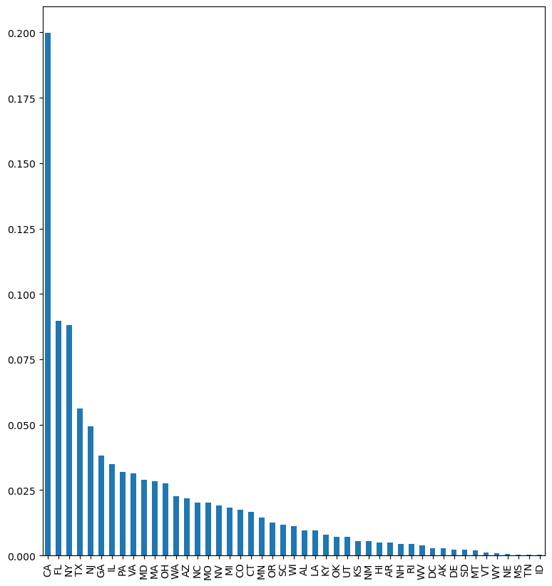
Exploratory Analysis – Key Findings
Defaulters % by Home ownership
Defaulters % by purpose
Defaulters % by state
Borrowers who own their homes have a lower default rate compared to those who do not own a home.
Loans taken for the purpose of debt consolidation have the highest default rate.
The state CA has the highest number of defaulters among all states.

Slide 10
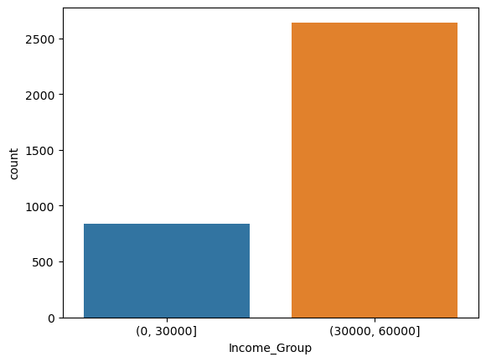
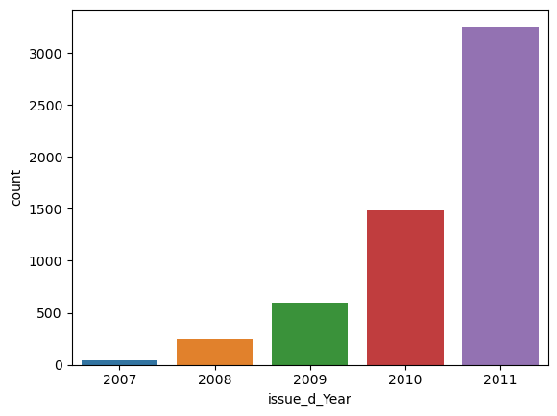
Exploratory Analysis – Key Findings
Defaulters by Income Group
Defaulters Trend By Year
The number of defaulters has been steadily increasing from year to year.
Individuals earning more than 30,000 are more inclined to default on their loans compared to those earning less than 30,000

Slide 11
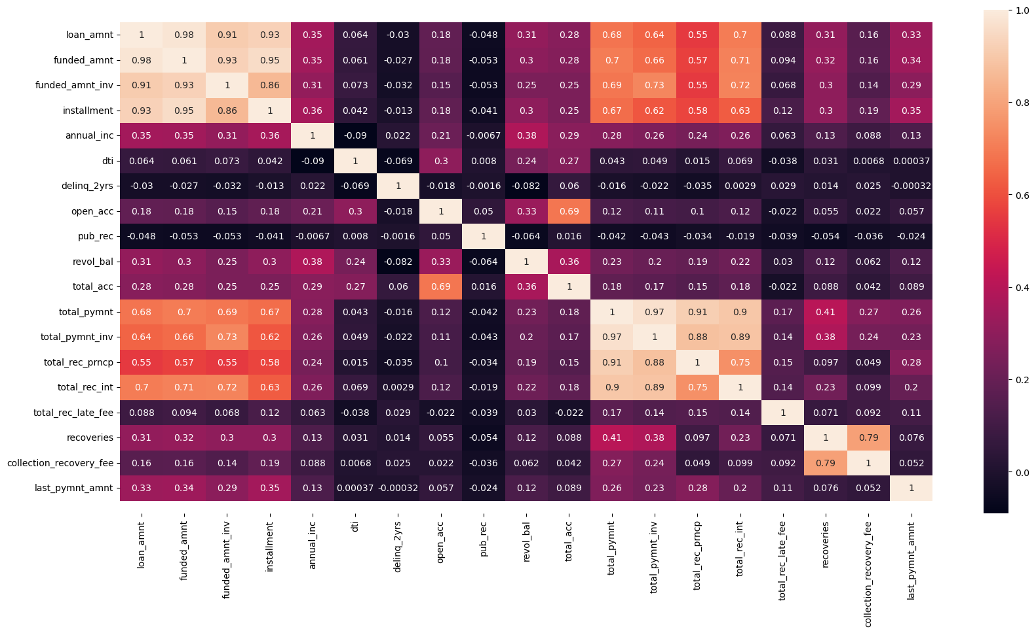
Exploratory Analysis – Key Findings
loan_amnt, funded_amnt, funded_amnt_inv& installment columns are highly correalted
2. total_pymmnt, total_payment_inv,total_rec_prncp,total_rec_int are moderatly correlated to point 1 columns
3. for the further analysis we could reduce the features which are highly correlated

Slide 12


Slide 13

Conclusion

Slide 14

Thank
You

